Slide 1

Supply
1.1.3 Demand, Supply and
Market Equilibrium

Slide 2

Learning objectives
Definition of supply.
The use of supply curve diagram to show:
  changes in price causing movements along a supply curve
  shifts indicating increased and decreased supply.
Factors that may cause a shift in the supply curve,
Today you will learn…

Slide 3

What is supply?
Supply definition:
The willingness and ability of producers to sell a good or service at a given price in a
given time period

Slide 4
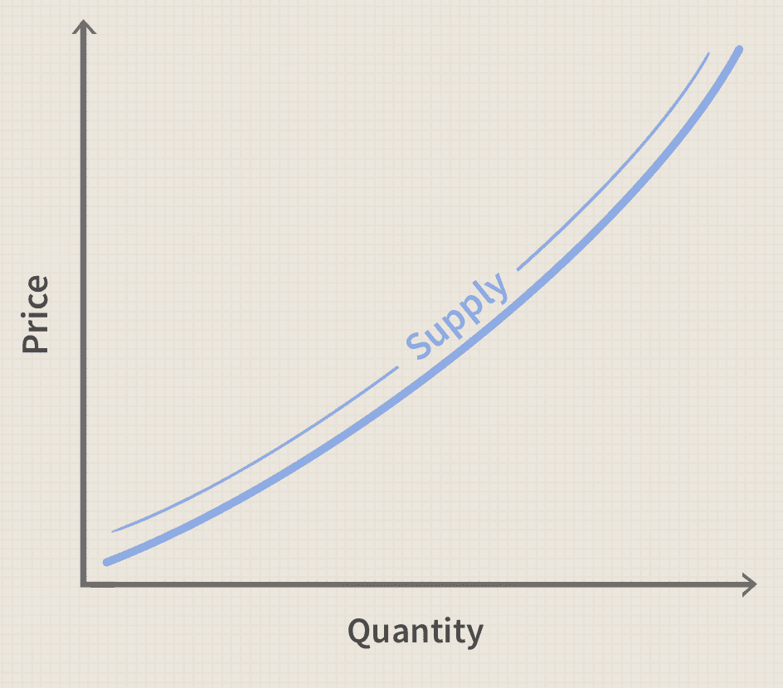
The Law of Supply
As the price of a product decreases the quantity supplied _________________
As the price of a product increases the quantity supplied _________________
It shows a positive relationship between price and output (Normal Goods)
As price increases, there is an incentive for firms to produce more of a product to increase their profits.

Slide 5
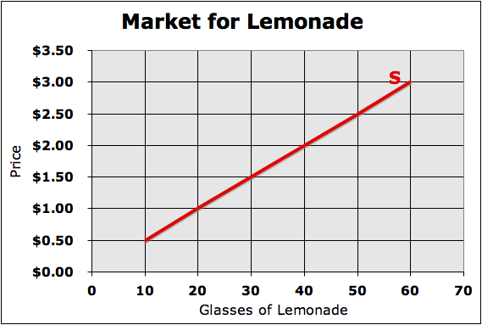
Supply can change in 2 ways
Change in “Quantity Supplied”
  This is just a change along the supply curve.
  Notice how the red supply line did not move. Just price changed, so we moved from one “quantity” to another.
Change in “Supply”
  This is a shift of the entire supply curve either “left” or “right.”
  Notice how the new red supply line shows that more lemonade will be supplied at every price.
S₂

Slide 6
Drawing the graph
QUIZ
Increase in supply
Rightward shift
Right = increase
Decrease in supply
Leftward shift
Left = decrease
S₂
S₂

Slide 7
Increases in Supply
There are six factors that will cause an increase.
Notes:
‹#›

Slide 8
Increase in supply - 6 Determinants of Supply
1) Costs of production decrease
$
This means that it costs less to make the item. Materials, wages, and operating costs are some things that might get cheaper.
Notes:
‹#›

Slide 9
Increase in supply - 6 Determinants of Supply
1) Costs of production decrease
2) Technology improves
New computers, new software, or new machinery could all make it easier to supply more products.
Notes:
‹#›

Slide 10

Increase in supply - 6 Determinants of Supply
1) Costs of production decrease
2) Technology improves
3) Sellers expect good things in the future
An economy that is expanding is always a good sign for suppliers. New homes are an indicator of good things in the future.
Notes:
‹#›

Slide 11
Increase in supply - 6 Determinants of Supply
1) Costs of production decrease
2) Technology improves
Grand Opening
3) Sellers expect good things in the future
4) More sellers enter the market
This means that a new business is entering the market, or a business already in the market is opening new facilities.
Notes:
‹#›

Slide 12
Increase in supply - 6 Determinants of Supply
1) Costs of production decrease
2) Technology improves
3) Sellers expect good things in the future
4) More sellers enter the market
5) Opportunities in different markets are bad
If related markets are doing poorly, suppliers will focus more attention on the current market.
Notes:
‹#›
This is probably the hardest one to comprehend of all six. Just imagine you are an automobile manufacturer. You spend half your time producing cars and half your time producing trucks. If the market for cars starts going bad (I.e. prices drop, or demand drops), you will probably focus more of your attention on making trucks. Thus, increasing the supply of trucks (while simultaneously decreasing the supply for cars).

Slide 13
Increase in supply - 6 Determinants of Supply
1) Costs of production decrease
2) Technology improves
3) Sellers expect good things in the future
4) More sellers enter the market
5) Opportunities in different markets are bad
Such events might include plenty of sunshine and rain for crops, or the restoration of peace in a war zone.
6) Favorable natural events
Notes:
‹#›

Slide 14
Decreases in Supply
There are six factors that will cause demand to decrease.
Notes:
‹#›

Slide 15
Decrease in supply - 6 Determinants of Supply
1) Costs of production increase
$
This means that it costs more to make the item. Materials, wages, and operating costs are some things that might get more costly.
Notes:
‹#›

Slide 16

Decrease in supply - 6 Determinants of Supply
1) Costs of production increase
2) Technology becomes outdated
If machinery is not replaced when needed, or if software is not updated, it will be hard to maintain a high level of supply.
Notes:
‹#›

Slide 17
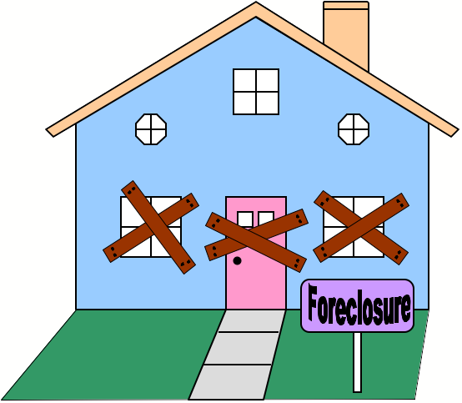
Decrease in supply - 6 Determinants of Supply
1) Costs of production increase
2) Technology becomes outdated
3) Sellers expect bad things in the future
An economy that is shrinking is a bad sign for suppliers. Foreclosures on homes are an indicator of bad things in the future.
Notes:
‹#›

Slide 18
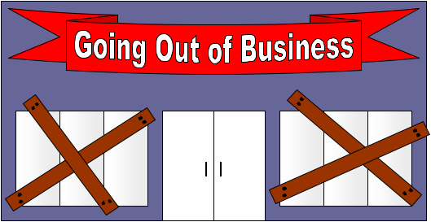
Decrease in supply - 6 Determinants of Supply
1) Costs of production increase
2) Technology becomes outdated
3) Sellers expect bad things in the future
4) Sellers leave the market
This means that a business was forced to close its doors, or a business already in the market closed some facilities.
Notes:
‹#›

Slide 19
Decrease in supply - 6 Determinants of Supply
1) Costs of production increase
2) Technology becomes outdated
3) Sellers expect bad things in the future
4) Sellers leave the market
5) Opportunities in different markets are good
If related markets are doing well, suppliers will shift some of their resources to the more profitable market.
Notes:
‹#›
This is probably the hardest one to comprehend of all six. Just imagine you are an automobile manufacturer. You spend half your time producing cars and half your time producing trucks. If the market for trucks is going well (I.e. prices rise, or demand rises), you will probably focus more of your attention on making trucks. Thus, decreasing the supply of cars (while simultaneously increasing the supply for trucks).

Slide 20
Decrease in supply - 6 Determinants of Supply
1) Costs of production increase
2) Technology becomes outdated
3) Sellers expect bad things in the future
4) Sellers leave the market
5) Opportunities in different markets are good
Such events might include droughts, floods, hurricanes, earthquakes, riots, or the outbreak of war.
6) Unfavorable natural events
Notes:
‹#›

